Slide 1
Status update

Slide 2
Things I have done
Finished the word embedding comparison
Made more actions
Implemented given actions on the UR robot
Created point and frame system

Slide 3
Word embedding
Kind of hard to test, if the word should be an action word… I would just add it to database. Don’t know the words that I don’t know

Slide 4
Actions I have
Move -> basic action
Rotate -> basic action
Pick up -> basic action not implemented physically
Put down -> basic action not implemented physically
Repeat -> meta action
Set point -> system developer action
Set frame -> system developer action
No pattern based actions

Slide 5
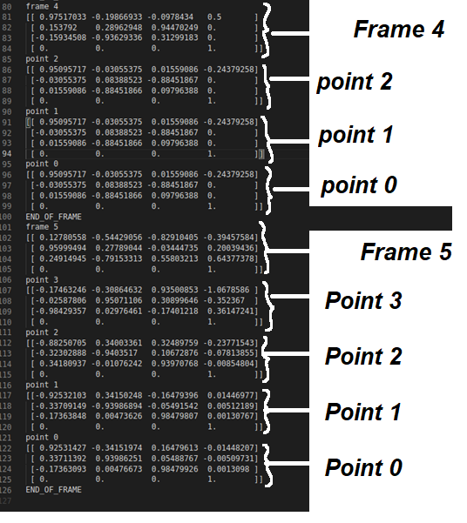
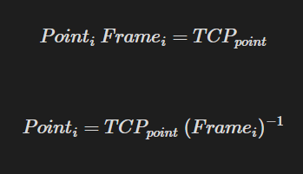
Point and frame system

Slide 6
Full system

Slide 7

Full system
Works!

Slide 8
Options for the future
Work more on the system: this guy
- implement movement based on frame “move 5 centimeters along the x-axis of the current frame”
- Create a pattern action – don’t do this
- Implement the gripper
Start on thesis soon:
Get the gripper up and working
Make evaluation tests with robot demonstrations using gripper
Use evaluations to begin writing thesis
Start on thesis VERY soon:
Forget the gripper
Make evaluation tests based on robot manoeuvring without a concrete task in question
Write thesis based on that evaluation

